Slide 1
Web Application Development ISCG7420 Introduction to Web Development
School of Computing, Electrical and Applied Technology

Slide 2
Outlines
Image
Rich text box
Add Related Model to Template
Many to Many Relationship to Template
Complete the blog
Heroku Deployment

Slide 3
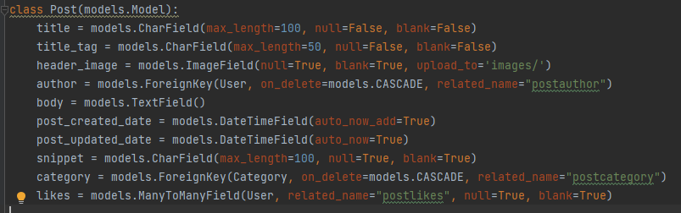
models.ImageField

Slide 4
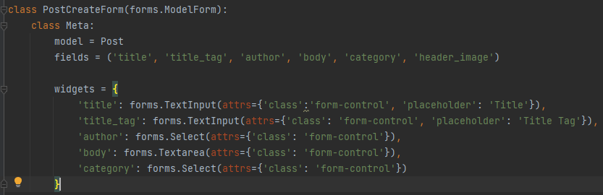
Add image to Form fields

Slide 5

Error shows out
makemigrations
migrate

Slide 6
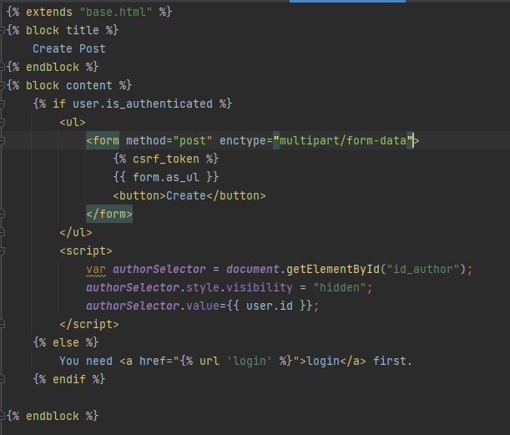
Template

Slide 7
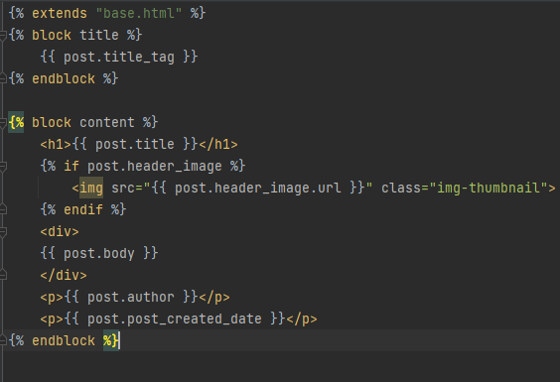
Show it out to detail page

Slide 8
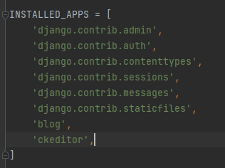
Rich Text Field
pip install django-ckeditor
Add ckeditor to setting

Slide 9
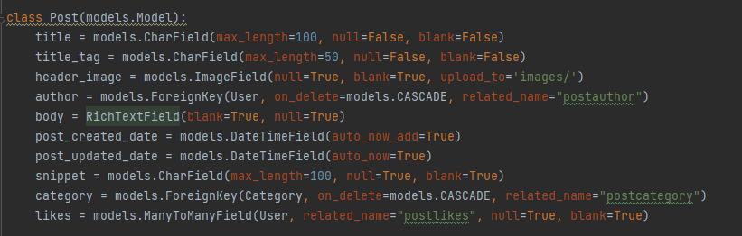
Change textfield to RichTextField
from ckeditor.fields import RichTextField

Slide 10
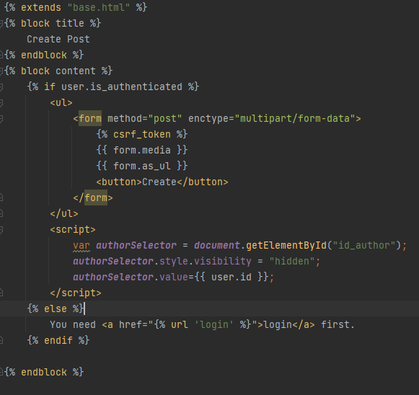
Add form media to template

Slide 11
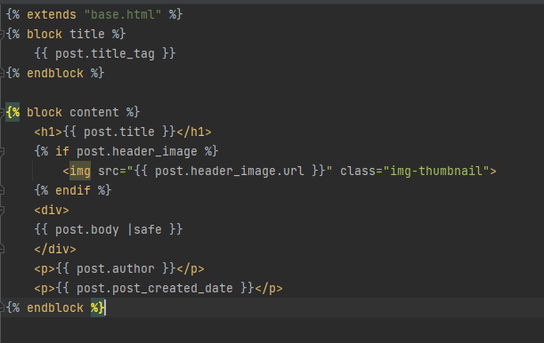
Add | safe to body display

Slide 12
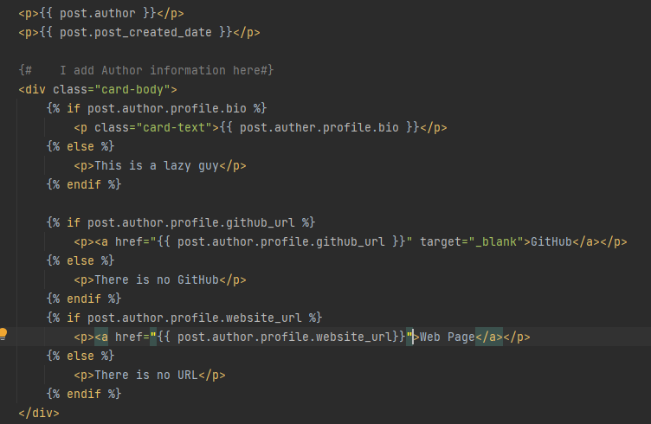
Add author detail to post page

Slide 13
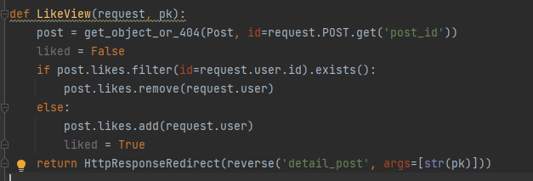
Create a function based view
url:

Slide 14
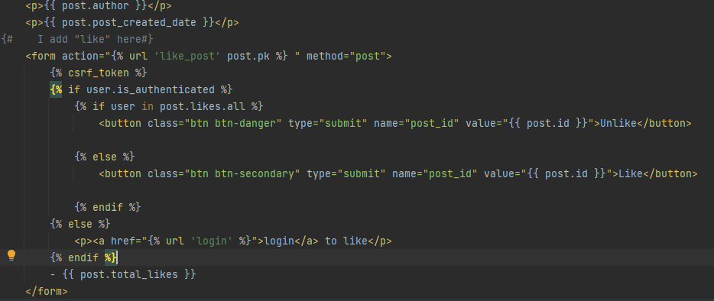
Add “Like” button to template

Slide 15
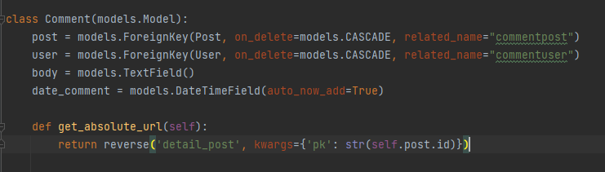
Model

Slide 16
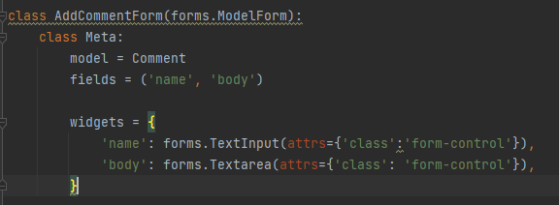
Form for comments

Slide 17
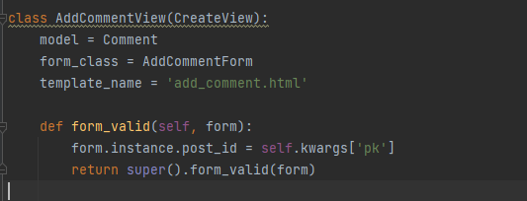
View

Slide 18
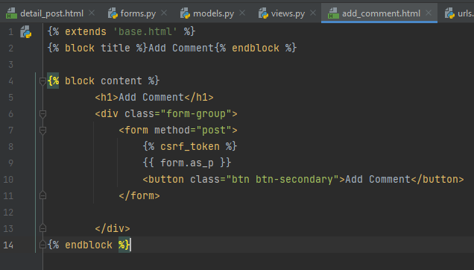
Template

Slide 19
Url

Slide 21
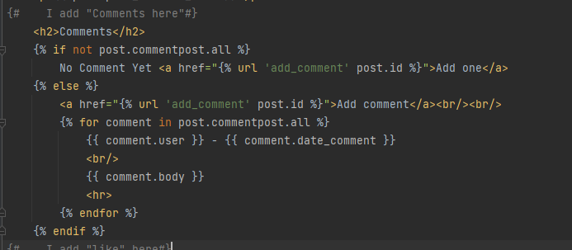
Post detail page

Slide 22
Heroku Deployment
https://dashboard.heroku.com/
Create an account
Create a project
Database connection
https://coderwall.com/p/mvsoyg/django-dumpdata-and-loaddata
Heroku git

